Slide 1

Cyclistic Case Study
GOOGLE DATA ANALYTICS CAPESTONE
BY RAJESWARY LEKSHUMANAKUMAR
02/2025
Notes:
NOTE:
To change the image on this slide, select the picture and delete it. Then click the Pictures icon in the placeholder to insert your own image.

Slide 2
What is the Objective of this cyclistic case study
Convert casual riders to members to drive long term business success.
To See how casual users ride differently than members.
What trends or relationships that we find in the data?
Top 3 recommendations based on the Analysis.

Slide 3
About Cyclistic Bike-Share Company
In 2016, Cyclistic launched a successful bike-share offering. Since then, the program has grown to a fleet of 5,824 bicycles that are geotracked and locked into a network of 692 stations across Chicago. The bikes can be unlocked from one station and returned to any other station in the system anytime.
Cyclist's marketing strategy relied on building general awareness and appealing to broad consumer segments. One approach that helped make these things possible was the flexibility of its pricing plans: single-ride passes, full-day passes, and annual memberships.
Customers who purchase single-ride or full-day passes are referred to as casual riders. Customers who purchase annual memberships are Cyclistic members.

Slide 4
Data Shortcomings
The dataset doesn’t include price of the rides.
Due to privacy protection law, we can’t see the customer purchase details
The dataset doesn’t include the gender and age of the riders. This led to minimal trend analysis.
We don’t have access to distance rode per trip

Slide 5
Data cleaning and Manipulation
Used Excel and PowerQuery for data cleaning and viz.
Validated the data type across dataset.
Removed columns rider_id, start_station_name, start_station_id, End_station_name and end_station_id since we are not using it in the analysis.
Create a column rider_length, to calculate the length of the ride by subtracting the column started_at from the column ended_at and multiply it by 24*60.
Created column month, day_name and season based on the month (1,2,3 fall,4,5,6 summer,7,8,9 spring,10,11,12 winter)
Removed columns start_station_id, end_station_id, since I not using those columns for analysis.

Slide 6
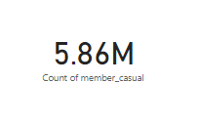
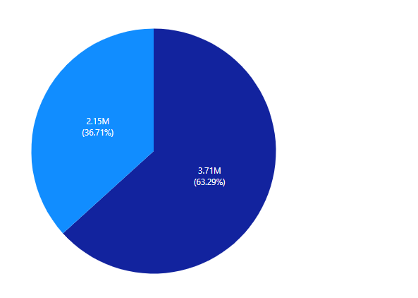

Overall Riders
Total of 5.86M riders in 2024

Slide 7
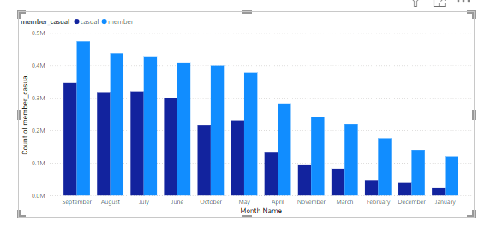
Monthly Riders
Busiest months was July, August and September.
Slowest month was December, January and February.
Member riders over take the casual riders.

Slide 8
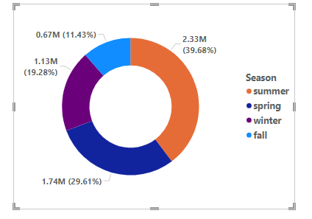
Seasonal Riders
Riders per seasons
Majority of the riders come from Summer and Spring.
Minimal riders in the fall season.
Member riders over take the casual riders.

Slide 9
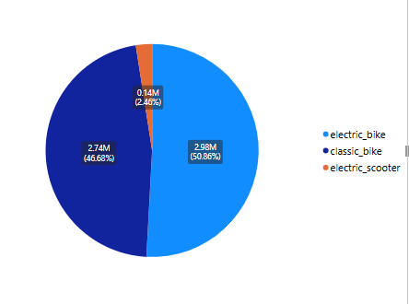
Preferred Bike Types
The most preferred bike type, according to the analysis, is the Electric bike, while the least preferred is the Electric Scooter.

Slide 10
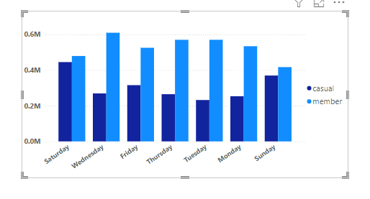
Daily Riders
Members ride more on weekdays.
Casual riders ride almost equally with Members on weekends.
Busiest weekday is Saturday.

Slide 11
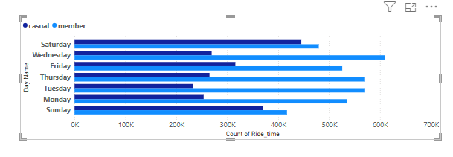
Average Rider Duration.
Riders per seasons
Members ride long on average than casual riders
15 minutes is the average ride time

Slide 12
INSIGHTS
Total Number of Riders in 2024 is 5.86 Millions.
2.15 millions are casual Riders.
3.71 millions are Annual Members
Busiest Month is June.
Busiest time is 5Pm.
Busiest season is Summer.
Busiest day is Saturday.
Most popular bike type is Electric Bike.
15 min is the average ride time.

Slide 13
Recommendations
Leveraging Social Media, Health Benefits Promotions, and Optimized Bike Distribution
To promote bikeshare programs successfully, coupled with maximization of their use, a more strategic approach encompasses targeted social media campaigns, health benefits focused promotions, and optimizing the distribution of bikes. This comprehensive strategy shall not only increase the visibility of this program but attract even larger audiences. It shall also unfold environmental awareness and help to have a greener urban environment.

Slide 14
Harness the Social Media Power: Use the massive reach and engagement by using Facebook, Twitter, YouTube, and Instagram to highlight benefits such as biking for sustainable living in cities.
Promote health benefits: Highlighting cycling's overall impact on good physical fitness and relief from stress while improving overall well-being is a pull for people with interest in healthier living.
Seasonal Membership Offerings: During summers, offer discounted seasonal memberships to attract casual riders and make the best use of the facility during peak periods.
Optimization of Bike Allocation: Docked less in low demand districts and relocated to surplus districts in high demand areas to provide an optimum user experience and increase utilization to achieve a balanced distribution.

Slide 15
Thank you

